Slide 1

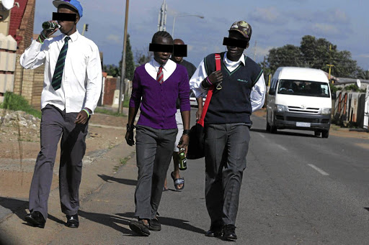
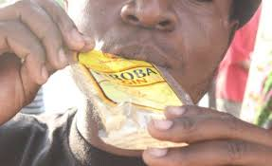
ALCOHOL IN ADOLESCENTS
Ministry of Education and Sports
THE EXTENT OF USE AND HARM IN SCHOOLS AND INSTITUTIONS IN UGANDA.
PRESENTED BY
GEORGE MUTEEKANGA
AC/PSI MOES

Slide 2


INTRODUCTION
Adolescence (10–19 years) is characterized by a series of developmental changes, which are highly impacted by social, cultural, and nutritional influences. Some of these behavioral characteristics, in turn contribute to a greater likelihood of initiating substance use.
Substance use by adolescents remains a significant public health concern. More than 50% of substance use initiation cases occur during adolescence. The common substance used among adolescents is alcohol, followed by marijuana and cigarette smoking.
By definition, alcohol is a colorless volatile flammable liquid which is produced by the natural fermentation of sugars and is the intoxicating constituent of wine, beer, spirits, and other drinks, and is also used as an industrial solvent and as fuel.

Slide 3
EXTENT OF USE
The contribution of alcohol consumption to global mortality is estimated to be 5.3 % which is higher than mortality due to tuberculosis (2.3 %), HIV/AIDS (1.8 %), diabetes (2.8 %) and road injuries (2.5 %).
Alcohol use leads to about 3 million deaths globally. It is the third leading risk factor for poor health globally and harmful use of alcohol was responsible for almost 4% of all deaths in the world, according to the estimates for 2018 [1].
Butabika Hospital records show that during child and adolescent clinic days that run every Tuesday and Wednesday, over 100 children are diagnosed with mental illness resulting from alcohol and substance abuse. https://www.newvision.co.ug/category/news/rising-mental-illness-among-youth-worries-but-135706

Slide 4
continuation
Alcohol is the drug of choice among youth. Many young people are experiencing the consequences of drinking too much, at too early an age. As a result, underage drinking is a leading public health problem in this country.
About 60 per cent of respondents in primary and secondary schools drink alcohol and more than a third have consumed marijuana, cocaine, and other prohibited drugs and substances, a new report by Makerere University School of Psychology led by Dr Leon Matagi, the lead researcher of the study has revealed.
He said up to three in every five children and one in every three who were interviewed reported that they had ever taken local alcoholic drinks or bottled alcohol respectively. Titled ‘Drug and Substance Abuse (DASA) in Primary and Secondary Schools in Uganda: Baseline Survey Implications for National Sensitisation’, the study focused on Primary Six and Seven pupils (2,392), and Senior Two and Three students (2,765) among other participants across the country between January and February 2020 before closure of schools due to the Covid-19 pandemic.

Slide 5
continuation
It has been reported that the COVID-19 pandemic has predisposed adolescents to risky behaviors such as substance use and subsequent substance use disorder (SUD). However, it is unknown how the pandemic has changed the prevalence of SUD among adolescents in Uganda.
In Uganda, 23% of school-going children (12 to 24 years) use addictive substances, especially alcohol (19.3%) and Kuber (smokeless tobacco, used sublingually) at 4.4% [13].
Prior Ugandan studies reported that factors associated with substance use (as opposed to substance use disorder) among adolescents include the death of a mother, suffering from chronic illness, depression, and having friends or family members with substance use problems. However, following the COVID-19 pandemic, substance use and substance use disorders have been reported to have increased along with changes in associated factors.

Slide 6
CONTINUATION
Among Ugandan high school students 28% (35% of boys and 24% of girls) have been binge drinking frequently (drinking five or more units of alcohol at the same occasion four or more times).
At most Ugandan high schools, alcohol play an integral role in the many social activities that make up the core of Ugandan high school culture, such as high school parties and study trips.
High schools host regular school parties (around five to ten per year) and pre-parties with heavy pre-dinking before going to the school party are common.

Slide 7
EXTENT OF HARM IN SCHOOLS AND INSTITUTIONS
Alcohol use could conceivably affect a student’s quality of learning and academic performance regardless of its impact on school completion.
Adolescents are prone to making changes to the extent that they feel socially accepted. As a result, their emotional instability by unfamiliarity and fear of new experiences or decision-making and low self-esteem can lead them to alcohol and illicit drug use, school problems, unprotected sex, legal problems, emotional changes, traffic accidents, suicides, and homicides. Furthermore, the risk of damage to organs, such as the brain, liver, and kidneys, and sexual dysfunction due to alcohol consumption is higher among the adolescents than in adults.

Slide 8
continuation
Ugandan adolescents have one of the highest prevalence of drunkenness among adolescents in East Africa. Although Butabika hospital bed capacity is 550 for admissions, daily the facility admits between 850 and 1000 patients. In addition, over 3000 patients are registered in the out-patient department mainly due to alcohol and substance abuse.
Alcohol is the most commonly used substance by students globally. It is contained in an array of beverages including beer, wine, spirits, cider, coolers or ‘alcopops’.
Globally, on average, about one in four 13–15 year olds report having used alcohol during the last 12 months – twice as many as used tobacco. https://www.unodc.org/documents/drug-prevention-and-treatment/UNODC_UNESCO_WHO_GoodPolicyAndPracticeInHealthEducation.pdf

Slide 9
Effects of alcohol abuse in schools
School problems, such as higher rates of absences or lower grades.
Social problems, such as fighting or lack of participation in youth activities.
Legal problems, such as arrest for driving or physically hurting someone while drunk.
Physical problems, such as hangovers or illnesses.
Unwanted, unplanned, and unprotected sexual activity.
Disruption of normal growth or sexual development.

Slide 10
continuation
Physical and sexual violence.
Increased risk of suicide and homicide.
Alcohol-related motor vehicle crashes and other unintentional injuries, such as burns, falls, or drowning.
Memory problems.
Misuse of other substances.
Changes in brain development that may have life-long effects.
Alcohol poisoning.

Slide 11
Literature on harmfulness of alcohol
Literature documents that young people who drink alcohol before the age of 15 years are more likely to perform poor at schools, drop out, develop alcohol dependence, as well as experiencing mental and social harm, and cardiovascular diseases, later in adulthood.
Most concerning is that high schools are believed to create some social and cultural surroundings, which may encourage alcohol use among the adolescents.

Slide 12
continuation
Health risks: Because young people’s bodies are still growing, alcohol will interfere with their development. This makes young people particularly vulnerable to the long-term damage caused by alcohol. This damage can include:
cancer of the mouth and throat
sexual and mental health problems, including depression and suicidal thoughts
liver cirrhosis and heart disease

Slide 13
Risky behaviour - sex
Young people are particularly at risk because at their stage of life, they are still testing the boundaries of what is acceptable behaviour.
One in five girls (and one in ten boys) aged 14 to 15 goes further than they wanted to in a sexual experience after drinking alcohol. In the most serious cases, alcohol could lead to them becoming the victim of a sexual assault.

Slide 14
Unsafe sex and unwanted pregnancy
If young people drink alcohol, they are more likely to be reckless and not use contraception if they have sex. Almost one in ten boys and around one in eight girls aged 15 to 16 have unsafe sex after drinking alcohol. This puts them at risk of sexual infections and unwanted pregnancy.
Research shows that a girl who drinks alcohol is more than twice as likely to have an unwanted pregnancy as a girl who doesn’t drink.
According to the Ministry of Health, 25 per cent of Ugandan teenagers become pregnant by the age of 19. Close to half are married before their 18th birthday and continue having babies into their mid-40s.

Slide 15



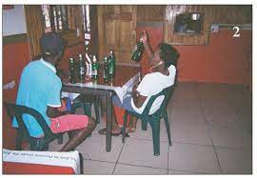
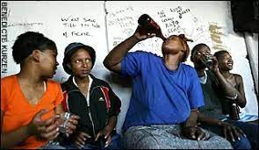
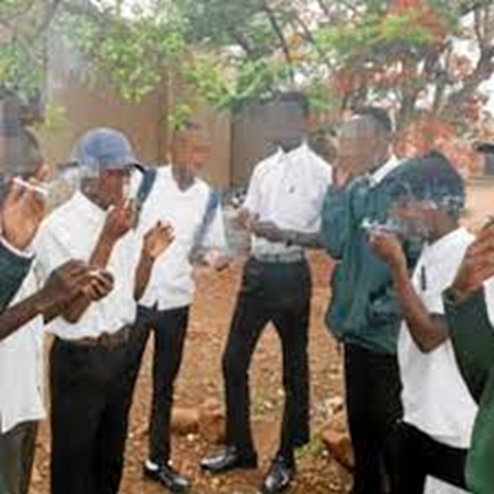
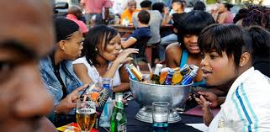
60% of school children take alcohol, says report
A new report suggests that about 60 per cent of students in primary and secondary schools have consumed prohibited drugs.

Slide 16
RECOMMENDATIONS/PRAYER
Inform the Public the dangers of Alcohol
Create awareness, mobilize, sensitize the key stakeholders in the Education Sector on the dangers of consuming Alcohol at an early age.
Key Stakeholders
Children/Students
Parents and Guardians
Head Teachers and Teachers
SMC’s, BOG’s and Governing Councils
Lower local government (LCI, LCII and LCIII/SAS)
Higher local government (DEO, DHO, DIS, DHI, LC V, CAO and RDC)
Community
Foundation Bodies/Religious Institutions
NGO’S and CSO’s
Media
Police
Parliament
Judiciary
MOES/MOH/MGLSD
Educational Development Partners

Slide 17
THANK YOU

